Slide 1

LegalEase: AI-Powered Legal Research
Assistant
Project Guide
Ms. Harsha Zope
Group Member | Student ID
Himanshu Kalwa | 23107102
Kishan Gupta | 23107066
Shreepad Haldankar | 23107031
Siddharth Kumar | 23107044

Slide 2
Outline
Introduction
Literature Survey of the existing systems
Limitations of the existing systems
Problem statement
System Design
Technologies and methodologies
Implementation
Conclusion
References

Slide 3

Sustainable Development Goals (SDG) mapped
SDG 16: Peace, Justice, and Strong Institutions
Supports fair access to information, reduces legal system burden, and enhances transparency.

Slide 4
Introduction
Accessing legal assistance in India remains expensive and complicated, especially for individuals unfamiliar with legal terminology or court processes.
Many people rely on unverified online sources or face delays in obtaining genuine legal advice from professionals.
Existing online tools provide static search results and general information but fail to interpret the unique context of each user’s issue.
The complexity of legal language and documents often discourages people from pursuing rightful action or understanding their rights.
To address these issues, LegalEase has been developed as an AI-powered legal assistant that simplifies law interpretation, provides quick case insights, and automates document generation for the public.

Slide 5
Introduction
Objectives:
To provide users with AI-generated legal support by analyzing Supreme Court judgments.
To enable users to perform case file research using optimized keyword search functionality.
To allow users to easily generate free legal documents like NDAs and rental agreements / Contracts.
To deliver all functionality through a simple, interactive chatbot UI.

Slide 6
Literature Survey of the existing system
Sr. No. | Title | Author(s) | Year | Outcomes | Methodology | Result
1. | A proposal of the Gamification for programming Learning Assistant System. | Htoo Htoo Sandi Kyaw,Etal | 2024 | To improve the Legal Literacy, Personalized Legal Learning and to enhance the user engagement. | Proposes a prototype design of a Programming Learning Assistant System using game mechanics to enhance engagement. | Presents a novel gamified approach to the learning.
2. | The development of a Collaborative Learning tool for AI Education. | Haibin Lai, Peng Peng, Etal | 2023 | It enhances the concept understanding and improves the Student Engagement and Personalized Learning paths. | Describes the development of a Collaborative tool specifically for AI Education, involving shared workspaces and learning modules. | Addresses the need for Collaborative tools in the specialized field of AI Education.

Slide 7
Literature Survey of the existing system
Sr. No. | Title | Author(s) | Year | Outcomes | Methodology | Result
3. | LiteDoc:Makes Collaborative editing Fast,Scalable and Robust. | Saptaparni Kumar,Etal | 2020 | To improve the Accuracy and Consistency and to simplify the Legal Document Creation. | Focuses on a conflict free,Scalable and Robust Framework for real time collaborative text editing. | Provides a strong architectural foundation for real time document synchronization.
4. | Real time Collaborative Code Editor with the AI Integration. | Smith J, Johnson A. | 2022 | To improve Collaboration and Communication and also to reduce the version conflicts. | Implementation of a web based collaborative coding environment with integrated AI assistance for code completion, error detection. | Combines the real time collaboration with AI powered coding assistance.

Slide 8
Limitations of existing systems
Survey Findings:
Legal research tools are too complex for the public.
E-commerce legal services are expensive and not user-friendly.
Access to legal information in plain language is limited.
Free interactive tools for document creation are scarce.
Gap to a Complete Solution:
No integration of complex legal data with public accessibility.
Lack of true personalization (e.g. plain language casa summaries).
No combined solution for challenges like AI hallucinations and data privacy..
Observations & Improvements:
Need AI –aware personalized legal suggestions.
Combined efficient search (FAISS) with language generation (RAG).
Add free automated document generation via a simple chatbot.
Hybrid approach (Gemini API for enhanced search ) is promising.
Confidence in Our Approach:
Can address legal accessibility, information and assistance
Our solution connects users to relevant past supreme court cases..
The next chapters of our proposed solution (LegalEase AI) will bridge this gap.

Slide 9
Problem statement
Understanding the legal system is very complex for the public, who have to deal with difficult laws, research past cases, and handle legal paperwork
Current legal tools are limited, focusing on confusing databases for experts or expensive services, without offering one simple solution for everyone.
People face major challenges like the high cost of legal help, difficulty understanding past cases, and no easy way to create legal documents for free.
Standard AI models are not reliable for legal tasks, failing to give accurate answers and avoid serious issues like providing false information and data privacy risks.

Slide 10
System Architecture & Methodologies
User Interface: Web dashboard UI for input (legal queries, user credentials, contract details).
Data Sources: Indian kannon API
AI Intelligence Engine (RAG):
Semantic Search (FAISS): Retrieves legal precedents based on conceptual meaning, not just keywords, using vector embeddings
Retrieval-Augmented Generation (RAG): Constrains the LLM to generate answers only from the retrieved, verifiable legal text to prevent hallucinations.
LLM (Google Gemini): Generates concise, accurate, and source-attributed summaries of the retrieved case law
Output: Fact-grounded summaries with verifiable source links, AI chatbot responses, and customized PDF legal documents (e.g., Contracts, NDAs).

Slide 11
Justification
FAISS is chosen for its high-speed similarity search in massive volumes of text, ensuring low-latency performance for the RAG pipeline.
RAG is essential to mitigate the risk of AI hallucination, which is unacceptable in the legal domain, by ensuring all outputs are fact-grounded.
Google Gemini is selected for its advanced reasoning and for showing fewer hallucination incidents in document analysis, making it a safer choice for a legal application.
Decoupled Architecture (Node.js for I/O, Python for AI) prevents computationally heavy RAG tasks from blocking user management, optimizing system stability.

Slide 12
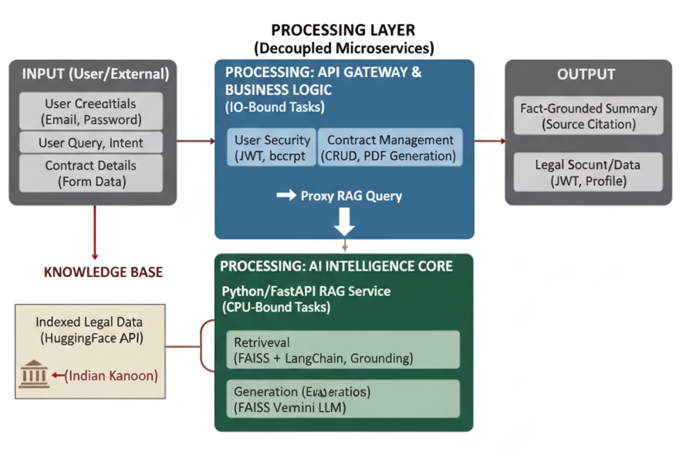
System Design
Fig 1: System Design for RAG + Decoupled Architecture

Slide 13
Technologies
AI and Intelligent Core:
  Google Gemini AI : The large Language Model used for text generation, summarization and chat.
  FAISS (Vector Research) : Enables efficient indexing and semantic retrievel of legal case embeddings.
  Sentence-Transformers : Generates the vector embeddings from legal text needed for semantic search.
Frontend Development:
  HTML, CSS3 (Glassmorphism)
  Vanilla JavaScript (ES6+)
Backend Development:
  Node.js (v18+)
  Express.js
  Key Libraries: bcrypt, jsonwebtoken, nodemailer.

Slide 14
Methodology
Data Ingestion and Sourcing: Gathering historical Indian case law from a HuggingFace Dataset and integrating live case data through the Indian Kanoon API to build a comprehensive knowledge base.
Data Preprocessing and Chunking: Pre-processing large legal judgments using Recursive-Based Chunking to break them down into smaller, logically coherent units that maximize contextual accuracy during retrieval.
Vector Embedding and Indexing: Converting the processed text chunks into dense vector embeddings and indexing them into a high-performance FAISS vector store to enable efficient semantic search.
Retrieval-Augmented Generation (RAG) Pipeline: Performing a high-speed vector search on the FAISS index to retrieve relevant legal chunks for a user's query , then using them as context for the Google Gemini LLM to generate a fact-grounded response
System Evaluation and Validation: Evaluating the final output using rigorous RAG-specific metrics like Faithfulness and Answer Relevancy to validate the system's accuracy and ensure the generated information is trustworthy.

Slide 15
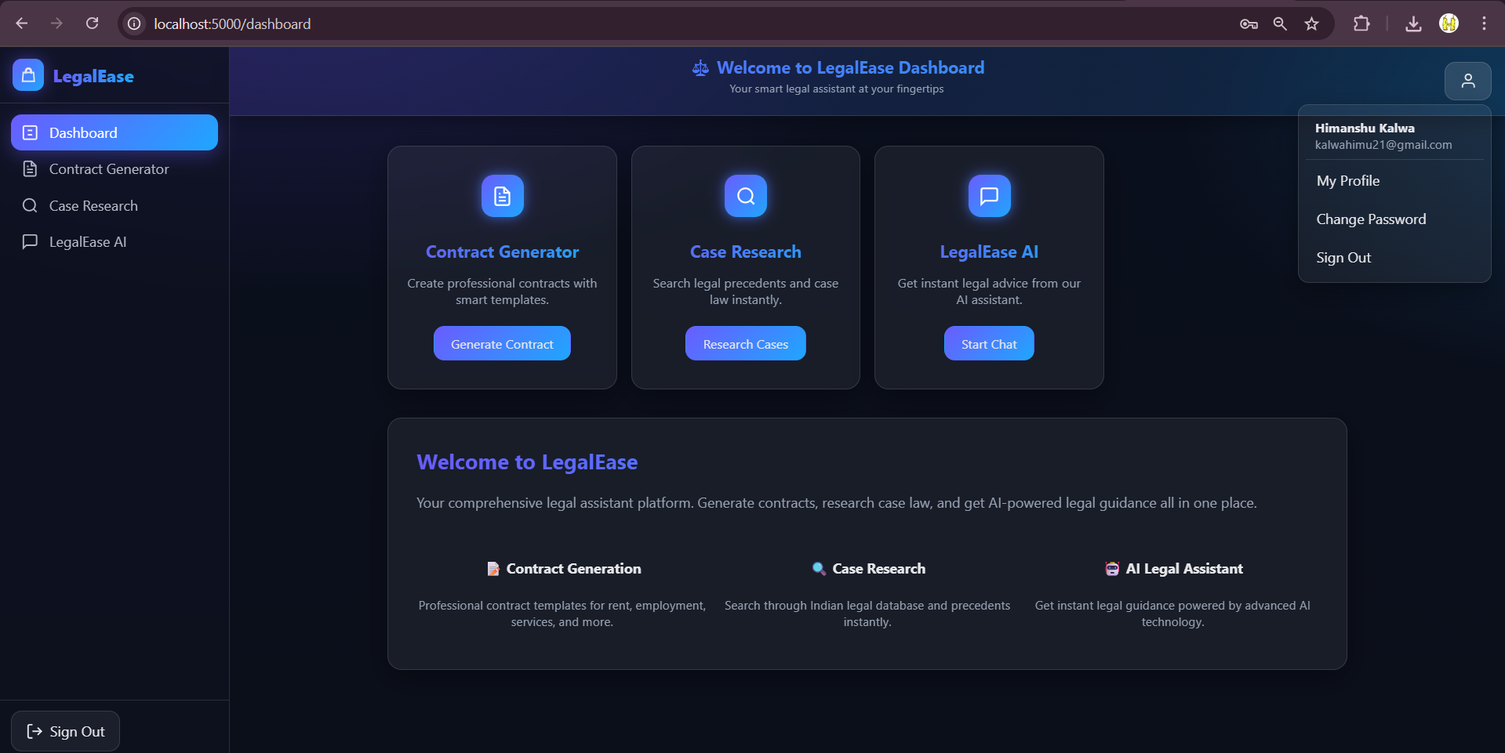
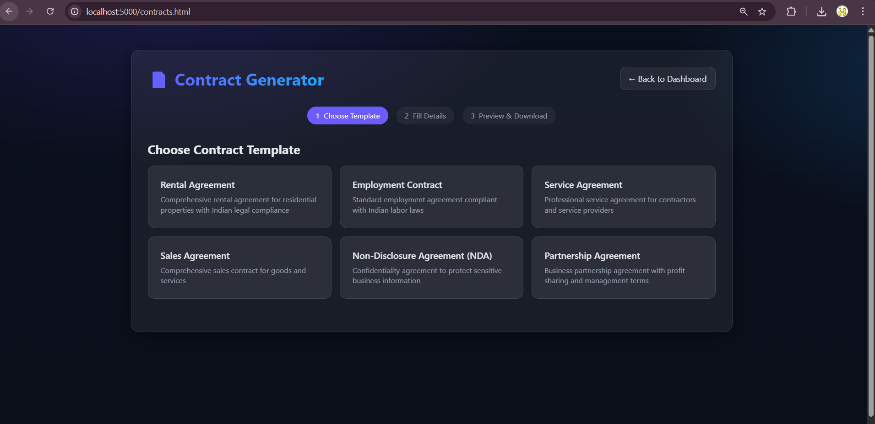
Implementation

Slide 16
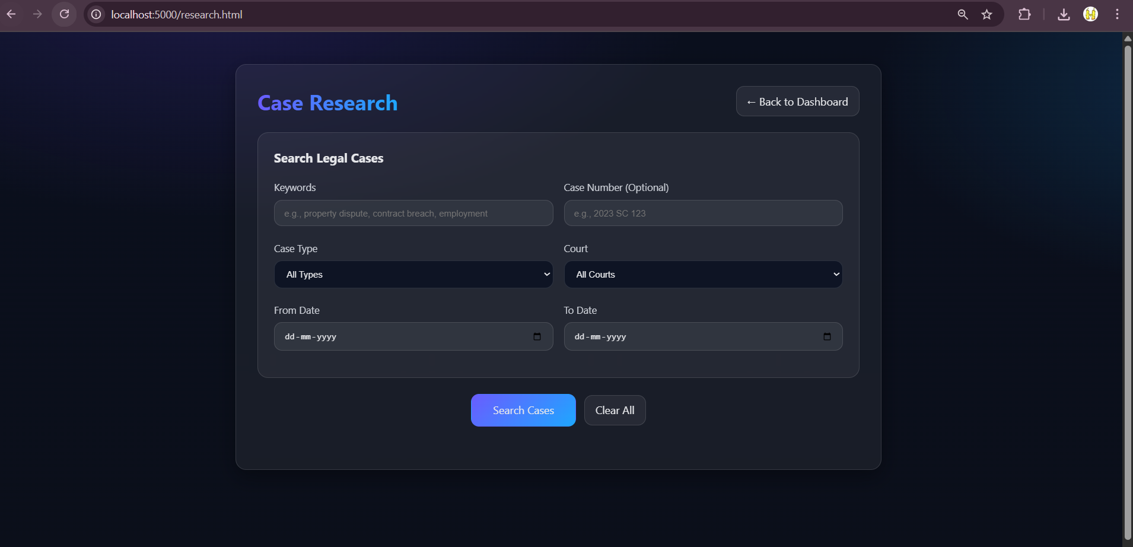
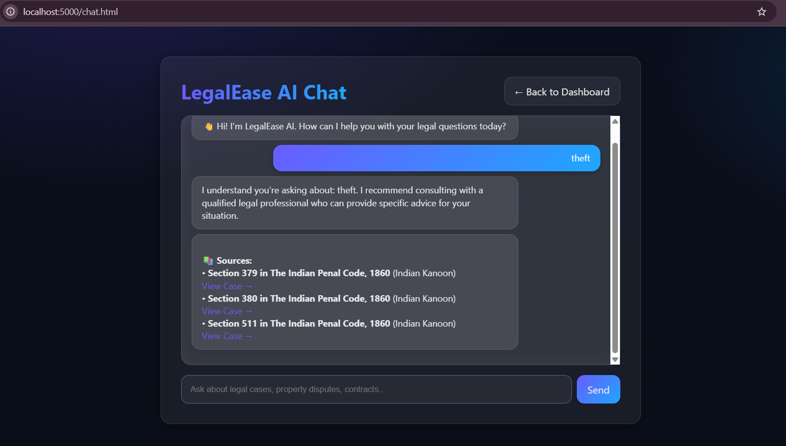
Implementation

Slide 17
Conclusion
We have developed LegalEase, a full-stack AI legal assistant featuring a decoupled architecture that integrates a Node.js backend with a Python RAG service, using FAISS and the Google Gemini LLM.
We have achieved a secure and fact-grounded system that provides verifiable case summaries , an interactive AI chatbot , and an integrated contract generator , while significantly reducing the risk of AI hallucination.
We have shown that the RAG model is more effective than traditional keyword search , ensuring that the information provided is accurate, source-attributed, and trustworthy for the legal domain.
Future advancements such as predictive modeling for case outcomes, integrated multilingual translation for legal documents, and integration with state-level administrative processes can be explored.

Slide 18
References
[1] LangChain: RAG tutorial / FAISS integration (official docs / tutorial) — implementation pattern for RAG + FAISS + LLM orchestration; cite in Implementation / RAG pipeline.
https://python.langchain.com/docs/tutorials/rag/
[2] Vision Document — e-Courts Project Phase-III (eCommittee / Government) — useful to justify project scope and national relevance (digital judiciary context); cite in Introduction / Scope & Motivation.
https://ecommitteesci.gov.in/document/vision-document-for-phase-iii-of-ecourts-project/
[3] jsonwebtoken (npm) — JWT library docs — practical reference for your auth implementation (JWT usage & best practices); cite in Technical Spec / Security.
https://www.npmjs.com/package/jsonwebtoken
[4] bcrypt (npm) — password hashing library — reference for secure password hashing (used in
your Node.js backend); cite in Technical Spec / Security.
https://www.npmjs.com/package/bcrypt

Slide 19
Thank You...!!

